Slide 1
Calculation of solar system

Slide 2
Step 1 :Load Arduino uno
Step 2 :Battery size selection in AH
Step 3 :charging current
Step 4 :solar panel selection
Step 5 :solar plates power

Slide 3
Step1:Load Arduino uno selection
I=200mA
Battery DC volt =5V
required power for Arduino
P = V×I
=200×5 =1W

Slide 4
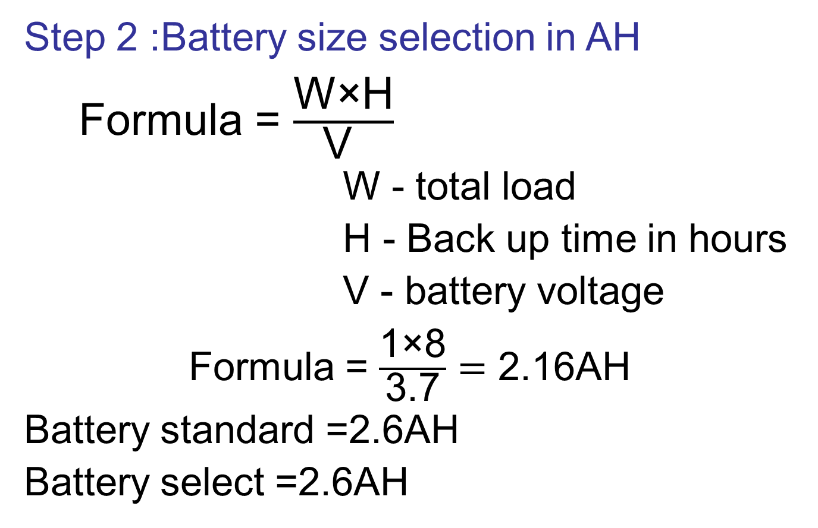

Slide 5
Step 3 : charging current
We will calculate charging current for 8AH battery.
As we know that charging current should be 10%of the AH rating of battery.
Therefore,
charging current for 2.16AH Battery
2.16×10%=0.216A

Slide 6
Step 4: solar plates current
= Battery chanrging current + Load current
=0.216+0.2
=0.416A
Step 5: Solar plates power
P = V×I
=6×0.416
=2.4W

